Slide 1

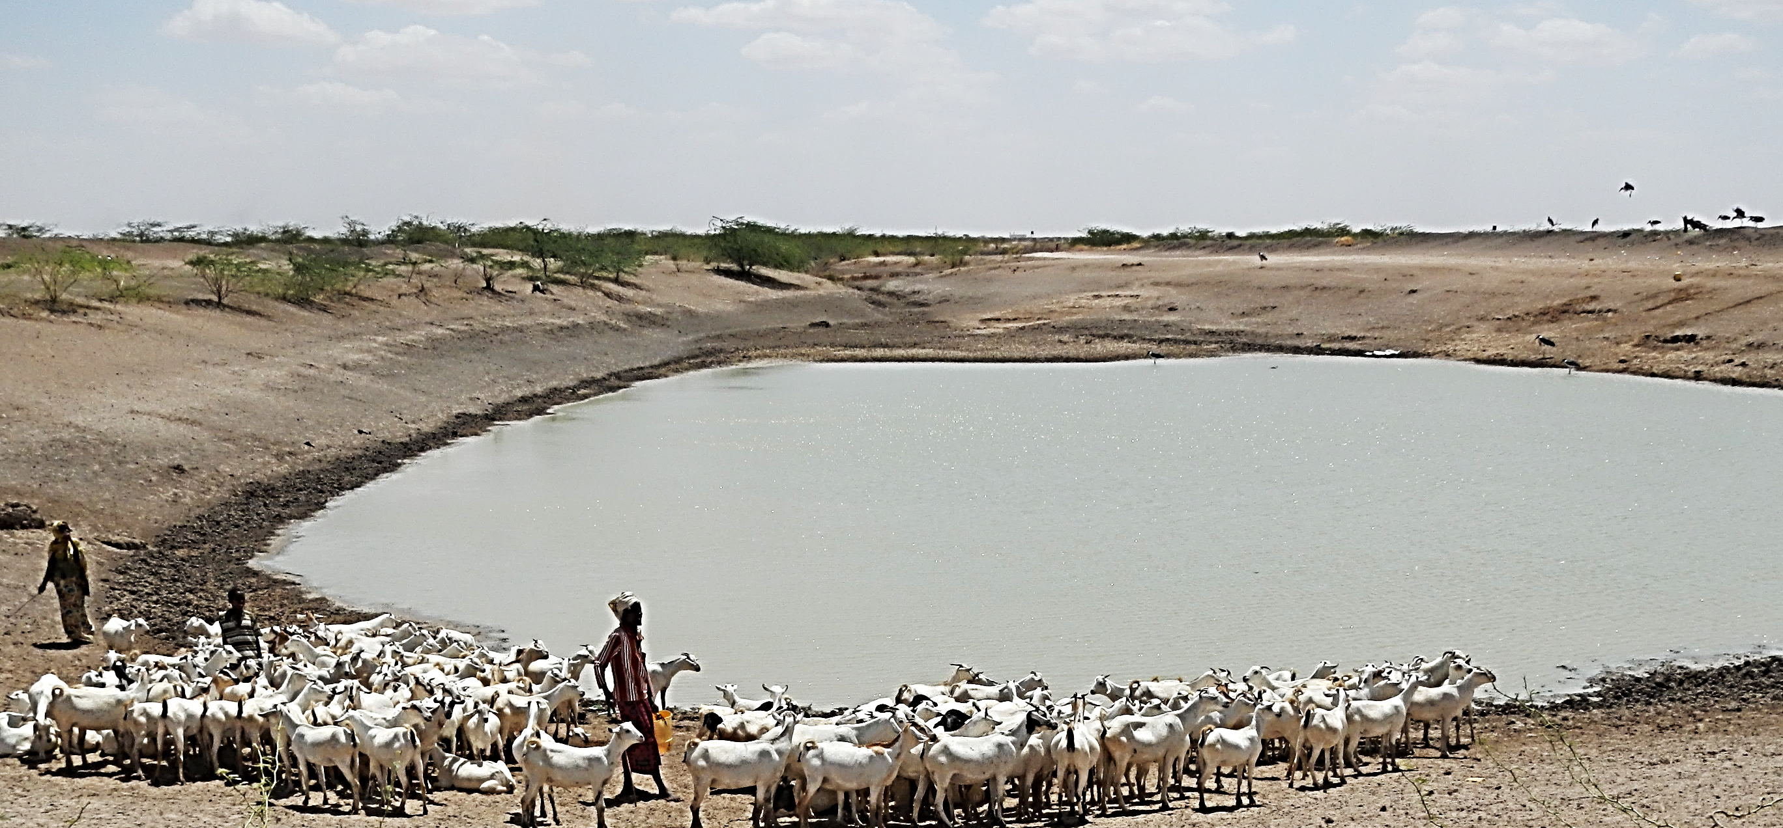
Index-Based Livestock Insurance (IBLI): Why, how, and with what impact?
Christopher B. Barrett, Cornell University
Talk to Cornell Planetary Health and
Cornell Zoo and Wildlife Society
February 11, 2019

Slide 2
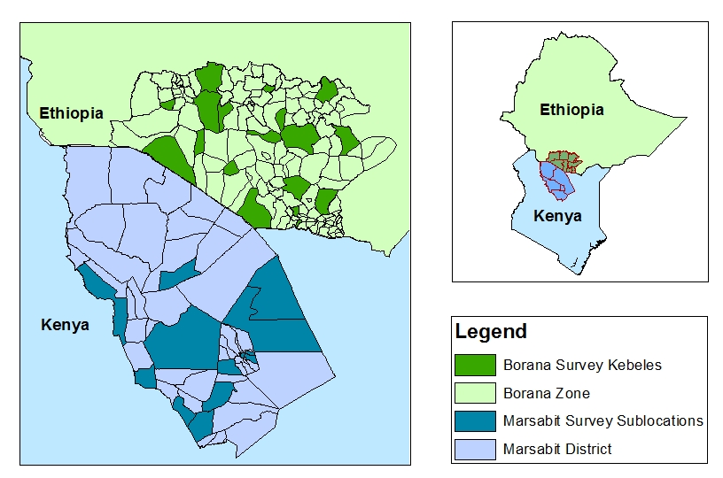
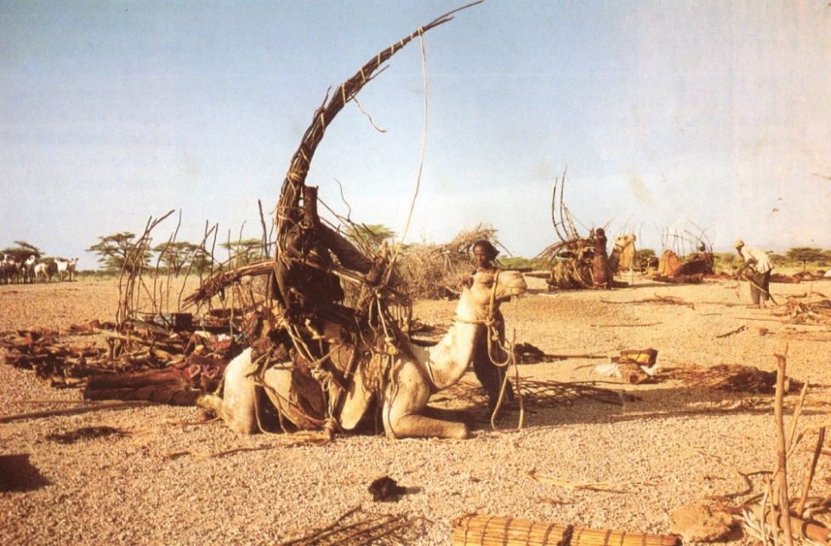
Why: Arid and Semi-Arid Lands (ASAL) of East Africa
ASAL livelihoods (and status) depend heavily on extensive livestock grazing.
Strong evidence of poverty traps arising from catastrophic herd loss due to major droughts.
Index-based livestock insurance (IBLI) was developed, piloted and scaled up to facilitate escape from drought-related poverty traps and to promote sustainable development in the region.

Slide 3
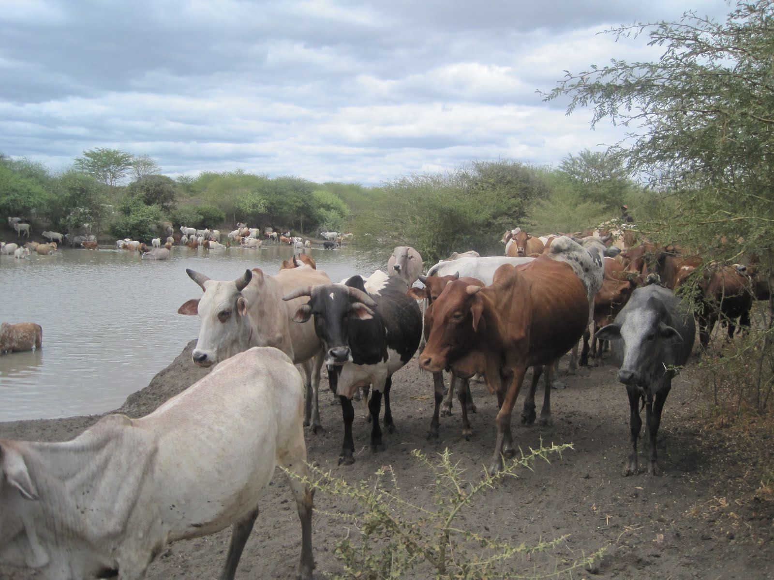
Why: Herd growth in good years
Under normal/good rainfall, virtually universal expectations of herd growth, with minimal dispersion among herders.
Source: Santos & Barrett (2018 UCP volume) on s. Ethiopian Boran

Slide 4
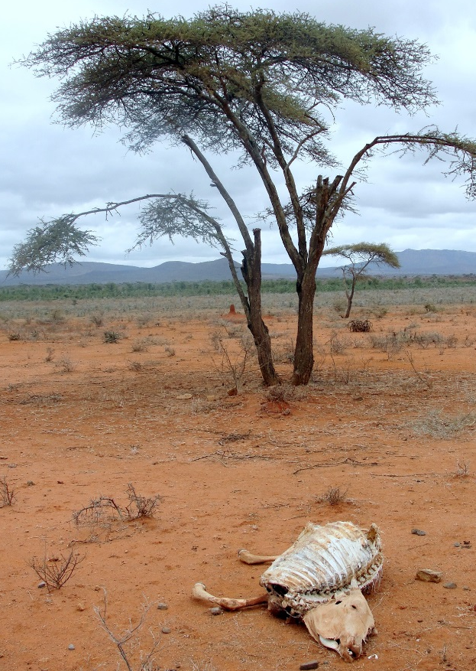
Why: Losses in drought years
But in drought years, considerable dispersion, and most herders expect to lose animals. Insurance and risk management ability suddenly become important differentiators.
Source: Santos & Barrett (2018 UCP volume) on s. Ethiopian Boran

Slide 5
Why: Expected herd dynamics w/stochastic weather
Blend state-specific results that strongly resemble observed
and get overall herd dynamics dynamics w/multiple equilibrium (Santos & Barrett UCP 2018) … poverty trap (Lybbert et al EJ 2004):
Different data and methods, but very strong correspondence: equilibria and expected dynamics very similar … in n. Kenya too (Barrett et al. JDS 2006).
Multiple dyn. equilibria imply a high return to risk management.

Slide 6
Why: Herder ability and expected herd dynamics
Now divide sample into two: lower ability group (4th quartile of the herding ability dist’n) and the rest. Re-estimate herd growth models for each sub-sample.
Find 2 distinct herd dynamics:
1. Low ability herders have just
one low-level equilibrium. Their
herds collapse inevitably over time.
2. Higher ability herders face
multiple dynamic herd equilibria.
Give them adequate herd, and
They can remain viable.
Different groups need different forms of support.
Source: Santos & Barrett (2018 UCP volume) on s. Ethiopian Boran

Slide 7
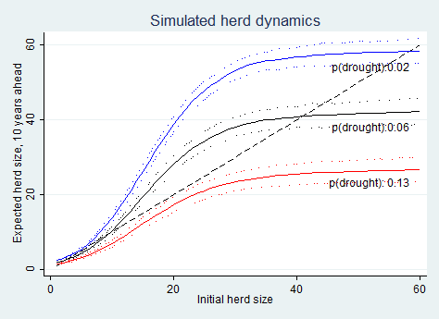
Why: Climate change threat
Herd dynamics differ b/n good and poor rainfall states, so change w/freq of drought risk (<250 mm/yr).
In so. Ethiopia, doubling drought risk would lead to expected system collapse if no disruption to current herd dynamics.
‘thriving herds’ dynamics
Current Boran dynamics
‘collapse’ dynamics
Source: Barrett and Santos (Ecol Econ 2014)
Climate change may be shifting system dynamics. Interventions to reduce herd loss – like water point/rangelands maintenance - and/or accelerate herd recovery – like livestock insurance – can affect dynamics and balance between two groups of pastoralists.

Slide 8
Why: Standard Responses to Drought
Standard responses to major drought shocks:
Post-drought restocking … negative ROI at low levels or if mistargeted
(Santos & Barrett UCP 2018)
2) Food aid (slow, expensive, can reinforce sedentarization (Nikulov et al. PLoS ONE 2016)
Core issue, “the social protection paradox”: If transfers go only to those already in a poverty trap, the poor population grows as shocks regularly knock some non-poor into the poverty trap. Over time, social protection resources get exhausted as the destitute population grows. (Ikegami et al. UCP 2018)
Solution: Build insurance-based safety net to help viable non-poor avoid preventable poverty, provide the unavoidably poor with reliable transfers.

Slide 9
How provide insurance?
Commercially sustainable insurance can perhaps:
  Prevent downward slide of vulnerable populations
  Crowd-in investment and accumulation by the poor
  Induce financial deepening by crowding-in credit
  Let us focus humanitarian resources on the needy
But can insurance be sustainably offered in the ASAL?
Conventional (individual) insurance unavailable b/c:
  Very high transactions costs, esp. w/little financial intermediation among pastoralists
  Moral hazard/adverse selection

Slide 10
How: Index insurance
Index insurance is a variation on traditional insurance:
  Do not insure individual losses.
  Instead insure some “index” measure that is strongly correlated with individual losses.
  (Examples: rainfall, remotely sensed vegetation index, area average yield, area average herd mortality loss).
  Index needs to be:
    objectively verifiable
    available at low cost in real time
    not manipulable by either party to the contract

Slide 11
How: Index insurance
Index insurance can obviate the problems that make individual insurance unprofitable for small, remote clients:
  - No transactions costs of measuring individual losses
  - Preserves effort incentives (no moral hazard) as no single individual can influence index
  - Adverse selection reduced as payouts do not depend on the riskiness of those who buy the insurance
In principle, use index insurance to create a timely, financially sustainable, self-targeting safety net to protect pastoralists vs. catastrophic drought shocks.

Slide 12
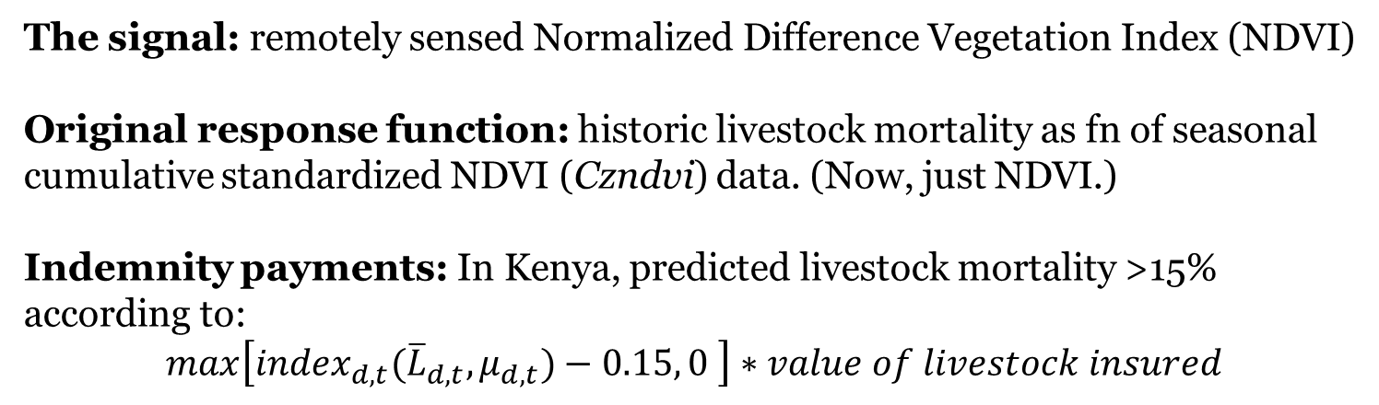
(Jensen, Barrett &2014)
How: IBLI design
The signal: remotely sensed Normalized Difference Vegetation Index (NDVI)
Original response function: historic livestock mortality as fn of seasonal cumulative standardized NDVI (Czndvi) data. (Now, just NDVI.)
Indemnity payments: In Kenya, predicted livestock mortality >15% according to:
$max\left[{index}_{d,t}({\overline{L}}_{d,t}, μ_{d,t})−0.15, 0 \right]∗value of livestock insured$
Temporal Structure of IBLI contract:
12 month contract sold during 2-month sales windows just prior to usual start of seasonal rains. Payouts March 1 and/or October 1.
Chantarat et al. JRI 2013

Slide 13
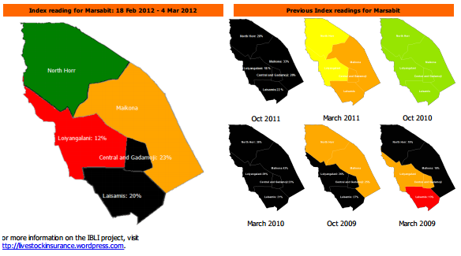
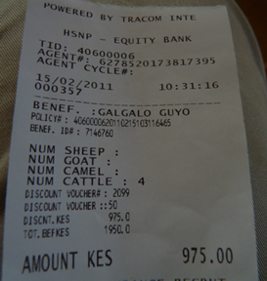
(Jensen, Barrett &2014)
How: IBLI implementation
First pilot in Marsabit County, Kenya, early 2010. In Ethiopia in 2012.
Technical lead: International Livestock Research Institute (CU/UCD backstop)
Commercial underwriters: In Kenya: UAP, APA, Takaful. In Ethiopia: OIC
International reinsurers: Swiss Re, Africa Re
Lots of implementation challenges.
IBLI team developed extension/financial education programs to
(randomly) inform prospective buyers.
Payouts have occurred
as designed! ☺

Slide 14
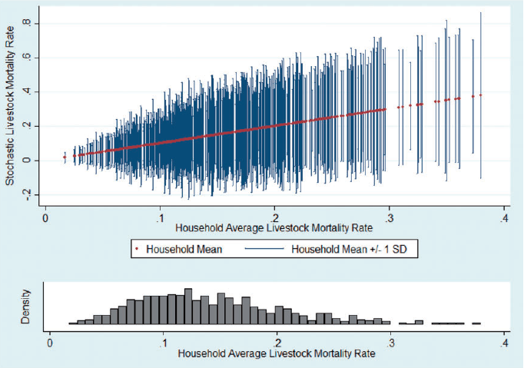
Impacts: An imperfect product
Covariate risk is important but household losses vary a lot …
… even for a given household over time.
Notes: The left figure illustrates the covariate (average) loss rate in each season. The right figure illustrates the distribution of losses within each seasons. The boxes depict the interquartile range, the upper and lower adjacent values are either 3/2 the interquartile range or the value furthest from the median. The remaining observations fall outside the adjacent values.
Notes: Household-season herd loss rate spreads (mean in red, ±1 SD in blue), ordered by hh avg loss rate (top), and distribution of hh avg loss rates (bottom).
Jensen, Barrett & Mude AJAE 2016

Slide 15
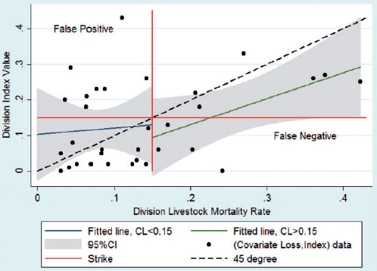
(Jensen, Barrett & Mude 2014)
Impacts: An imperfect product
And the index does not perfectly track covariate losses.
Notes: Covariate loss-index observations are seasonal division average mortality paired with the index value for that division-season. Fitted lines and confidence intervals are generated by regressing livestock mortality rates on the index.
- IBLI hhs still hold most risk: 62-77% of total risk exposure remains
Most basis risk is idiosyncratic and random, not targetable/correctable.
Significant design risk (unintended systematic underpayment)
- Signif. spatial variation in covariate share – geographically target IBLI?
Jensen, Barrett & Mude AJAE 2016

Slide 16
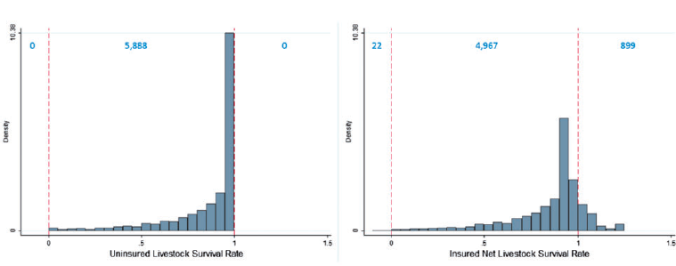
(Jensen, Barrett &
Impacts: An imperfect product
Because of basis risk, esp. false negatives, buying IBLI cannot stochastically dominate no insurance. Are buyers better off?
Survival rate w/o IBLI (L) and net of prem/indem payments w/IBLI (R).
Note: - small probability of negative survival rates!
- increased dispersion of outcomes due to false payments>losses
Jensen, Barrett & Mude AJAE 2016

Slide 17
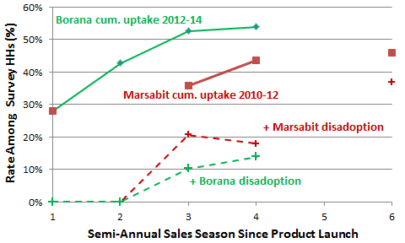
Impacts: Significant uptake and disadoption both
In HH surveys , in Borana (Ethiopia)/Marsabit (Kenya):
54/44% ever purchased IBLI within first 4 sales periods
But repurchase rates low: 18-68%/16-27%
High rates of disadoption : 26/41% within 2 years

Slide 18
Impacts: Key determinants of IBLI purchase
General uptake findings — robust across specifications/surveys
Price: Price inelastic response to premium rate.
Design Risk: Design error reduces uptake, esp. at higher premium rates.
Idiosyncratic Risk: Hh understanding increases effect of idiosyncratic risk.
Understanding: Extension/marketing improves accuracy of IBLI knowledge but no independent effect of improved understanding on uptake.
Herd size: Likelihood of uptake increasing in HH herd size.
Liquidity: IBLI purchase increasing w/HSNP participation and HH savings.
Intertemporal Adverse Selection: buy less when expect good conditions.
Spatial Adverse Selection: HHs facing more covariate risk are more likely to purchase and purchase more (spatial adverse selection).
Gender: no gender diff in uptake. Women more sensitive to risk of new product.
Sources: Bageant & Barrett JDS 2016; Takahashi et al. WD 2016; Jensen, Mude & Barrett FP 2017

Slide 19
Impacts: Less adverse post-drought coping
N. Kenya HHs received IBLI indemnity payments in October 2011, near end of major drought. Survey HHs with IBLI coverage report much better expected behaviors/outcomes than the uninsured:
36% reduction in likelihood of distress livestock sales, especially (64%) among modestly better-off HHs (>8.4 TLU)
25% reduction in likelihood of reducing meals as a coping strategy, especially (43%) among those with small or no herds
Builds resilience (i.e., reduces probability of adverse outcomes) in herd size, child MUAC among northern Kenya herders.
In s. Ethiopia, IBLI seems, if anything to crowd in more informal transfers, so reinforces informal safety net systems.
So, IBLI appears to augment safety net, reducing reliance on the most adverse behaviors undertaken by different groups.
Sources: Cissé & Ikegami WP 2017; Janzen & Carter AJAE 2018; Tafere et al. AJAE 2019; Takahashi, Barrett & Ikegami AJAE 2019

Slide 20
Impacts: Higher well-being indicators
At least two ways IBLI can influence well-being:
1) Non-monetary (psychological) benefits or costs
  Insurance causes peace of mind over adverse outcomes
  Buyer’s remorse wrt lapsed contracts that don’t pay out
  Net effect strongly positive
    2) Monetary benefits or costs – effect on net income/wealth
  Premium payment reduces net income/wealth, indemnity payment increases it … net indemnity payments generally negative
  But change risk-adjusted returns to livestock holding. Reduced non-drought herd size in Kenya (precautionary savings?), increased non-drought herd size in Ethiopia (better risk-adjusted ROI?)
  Initially reduces herding effort, but recovers as herders learn IBLI
  Increases animal health care expenditures, milk income/TLU, total hh income, child MUAC
  Marginal benefit/cost on income/MUAC 6-45x that of cash transfers!
    Even with prospective buyer’s remorse, IBLI purchase increases pastoralists’ subjective well-being.
Sources: Jensen, Barrett & Mude JDE 2017; Tafere et al. AJAE 2019; Toth et al. 2018

Slide 21
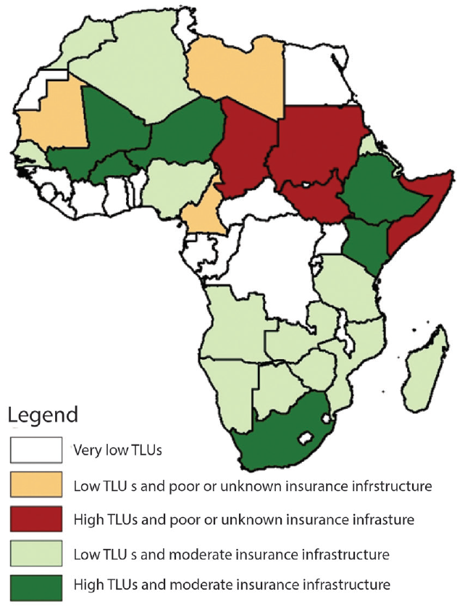
IBLI: Next steps
Sharia-compliant version already successfully launched (Takaful)
Kenya gov’t nationwide via Kenya Livestock Insurance Program
Now reviewing new, appropriate sites where partners have requested help:
Significant livestock herds
face high covariate herd loss risk related to drought
adequate insurance infrastructure
Best bets for next expansions: Niger, Mali, Burkina Faso, South Africa
(higher risk sites: Chad, Somalia, South Sudan, Sudan)
(Mills et al. 2016)

Slide 22
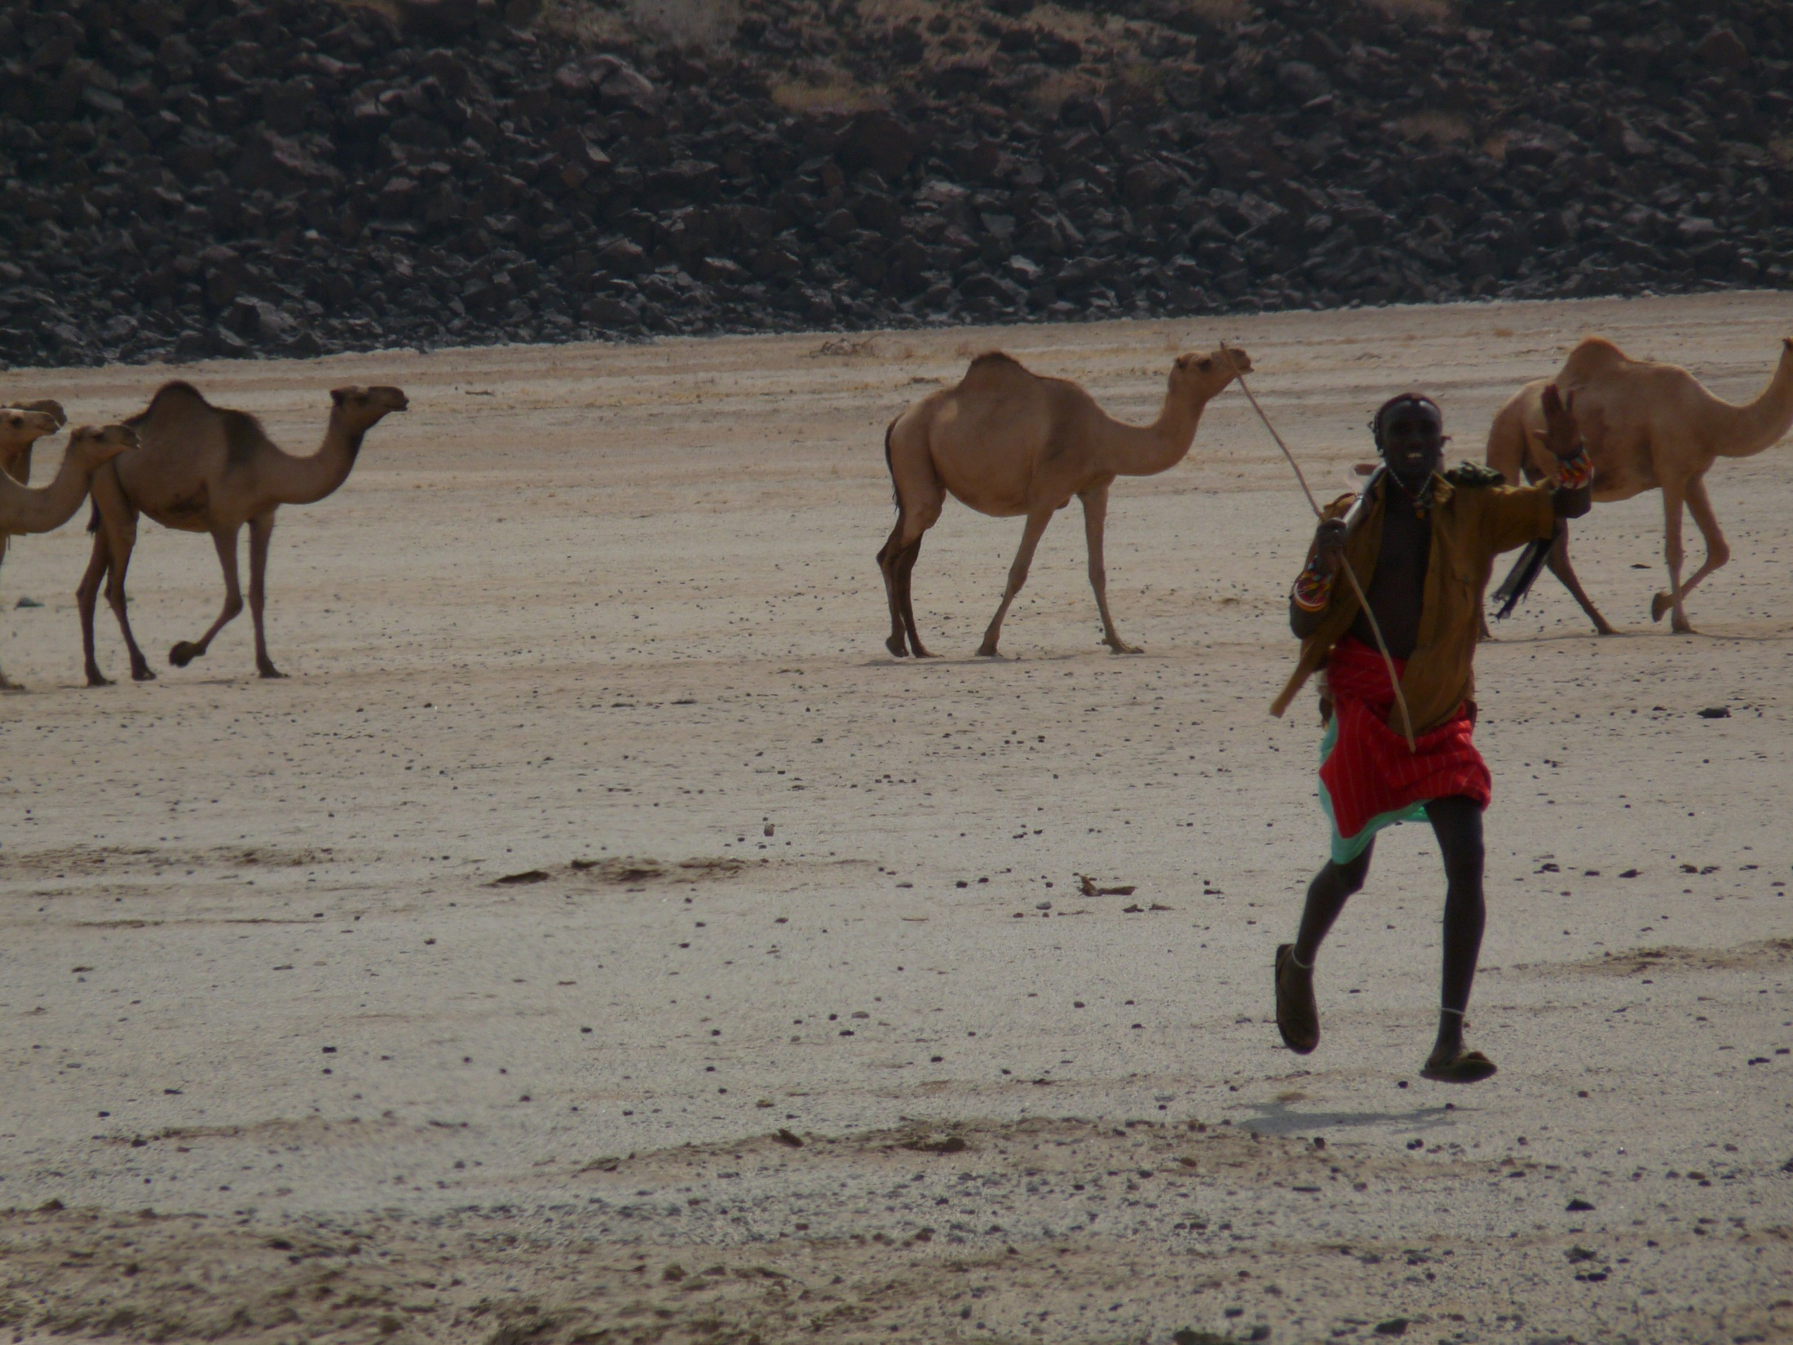
IBLI offers incomplete and imperfect coverage against herd loss. But solid uptake and scale-up/out w/clear, favorable impacts on purchasers.
IBLI offers promising option for addressing poverty traps that arise from catastrophic drought risk … w/impacts/$ > cash transfers
Thank you for your time, interest and comments!
For more information visit www.ilri.org/ibli/
Notes:
22

